Slide 1

Beaverton University
Management sys.
- Kefu Zhou

Slide 2
Beaverton University’s Project
1. Instruction | 2. Framework | 3. Inside of project | 4. Code sample
Structure and Scope | Razor Pages in ASP.NET Core | The database the data model and Entity | C#，HTML CSHTML
The functions | EF Core Bootstrap | Razor pages objects | SQL LINQ Data Annotations
The screens created in the project | Identity framework | Data migration Revers engineering | CSS，Bootstrap Microsoft Edge Devtools

Slide 3
Project: Beaverton University
I am applying the development job on ASP.NET Core. This project is to show the understanding of system development and needed skill set.
Beaverton University is a basic university web site. Users can view and update student, course, and instructor information.
The prototype of the project is Razor Pages with Entity Framework Core in ASP.NET Core that is developed by Microsoft. This is the key sample document for the developers of Razor Page in ASP.NET Core for years.
ASP.NET Razor Pages is a server-side, page-focused framework that enables building dynamic, data-driven web sites with clean separation of concerns
As developer of Razor Page Core What you know. What you do. What you see, What you get.
This project is with Kefu Zhou’s resume.

Slide 4






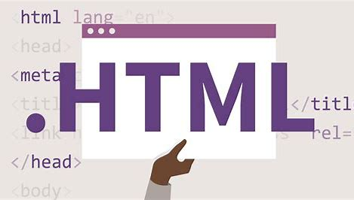






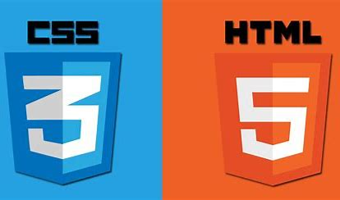
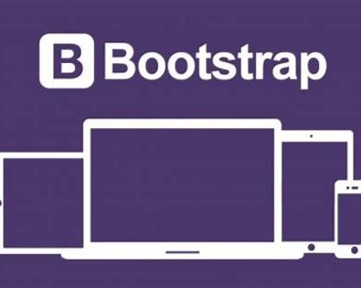
Structure and Scope
SQL 2019
Manager
EF Core
Student
DataModel
ASP.NET Core RazorPage
Teacher
ASP.NET Core
ASP.NET Core Data Annptation
ASP.NET Core Identity

Slide 5
Functions - system point of view
Login: Manages users, passwords, profile data, roles, claims, tokens, email confirmation, and more.
CRUD operations for objects: c- Create, r- Read, u-Update, d-Delete
Business roles such as 1. UI Switch 2. Admin 3. Assignment 4. Code list restriction 5. Operation restriction, …
Operations: 1. Efficiency: Tab key order, first focus on page, … 2. Data-clean: Validation, Format and Message 3. Easy maintenance
Users are in 3 categories: Manager, Student and Teacher
Manage objects: 1. Users 2. Course 3. Enrollment 4. Course assignment 5. Credits

Slide 6
Overview
Screens key technologies

Slide 7
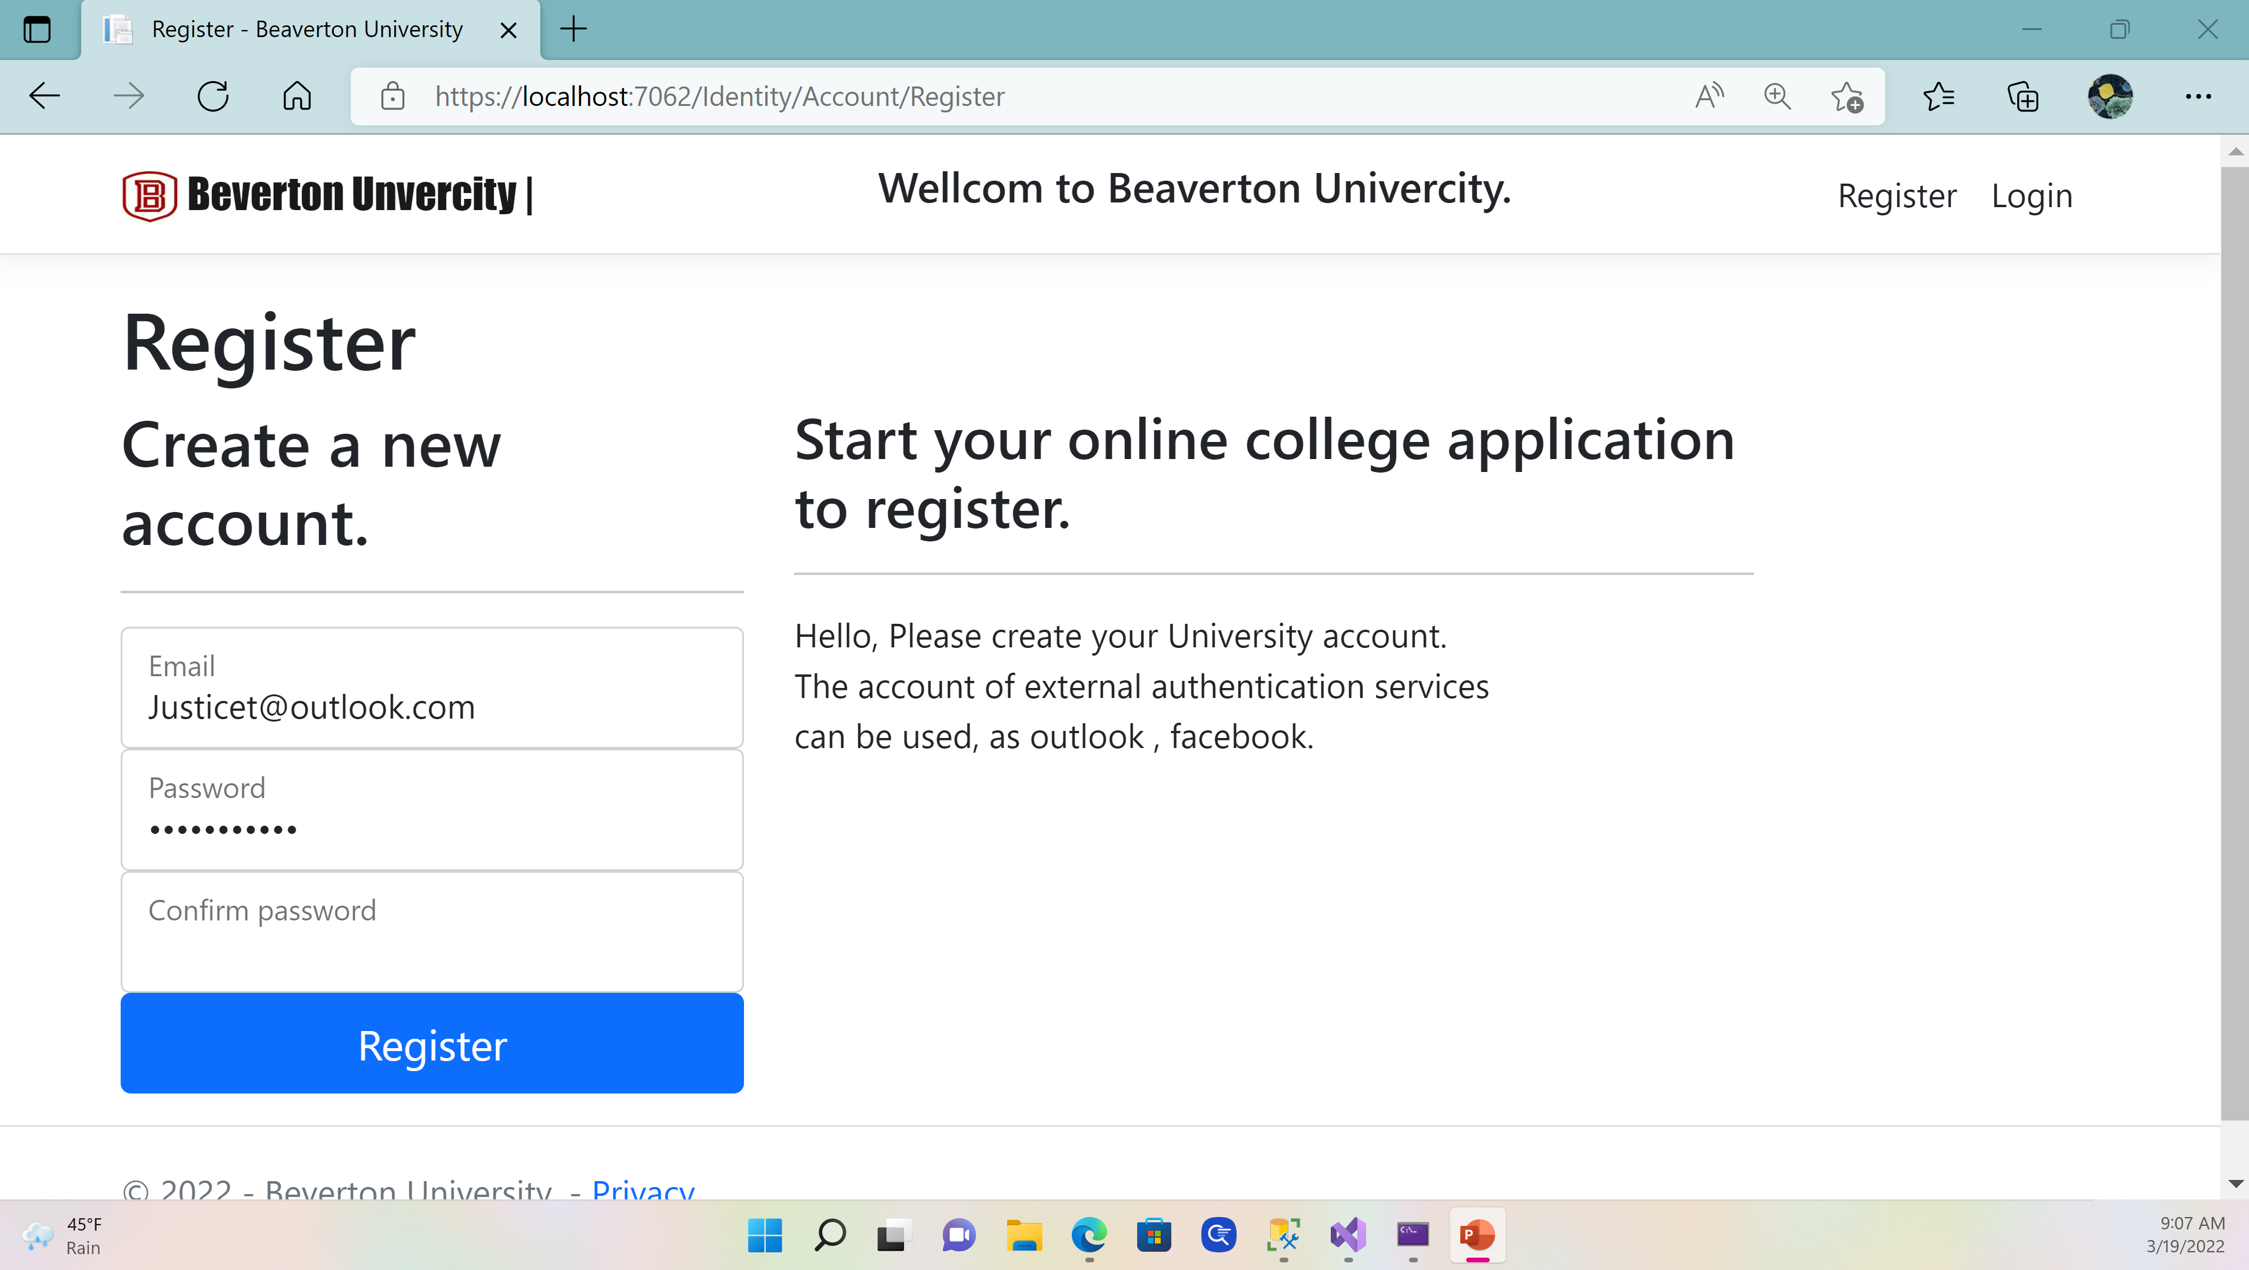

Slide 8
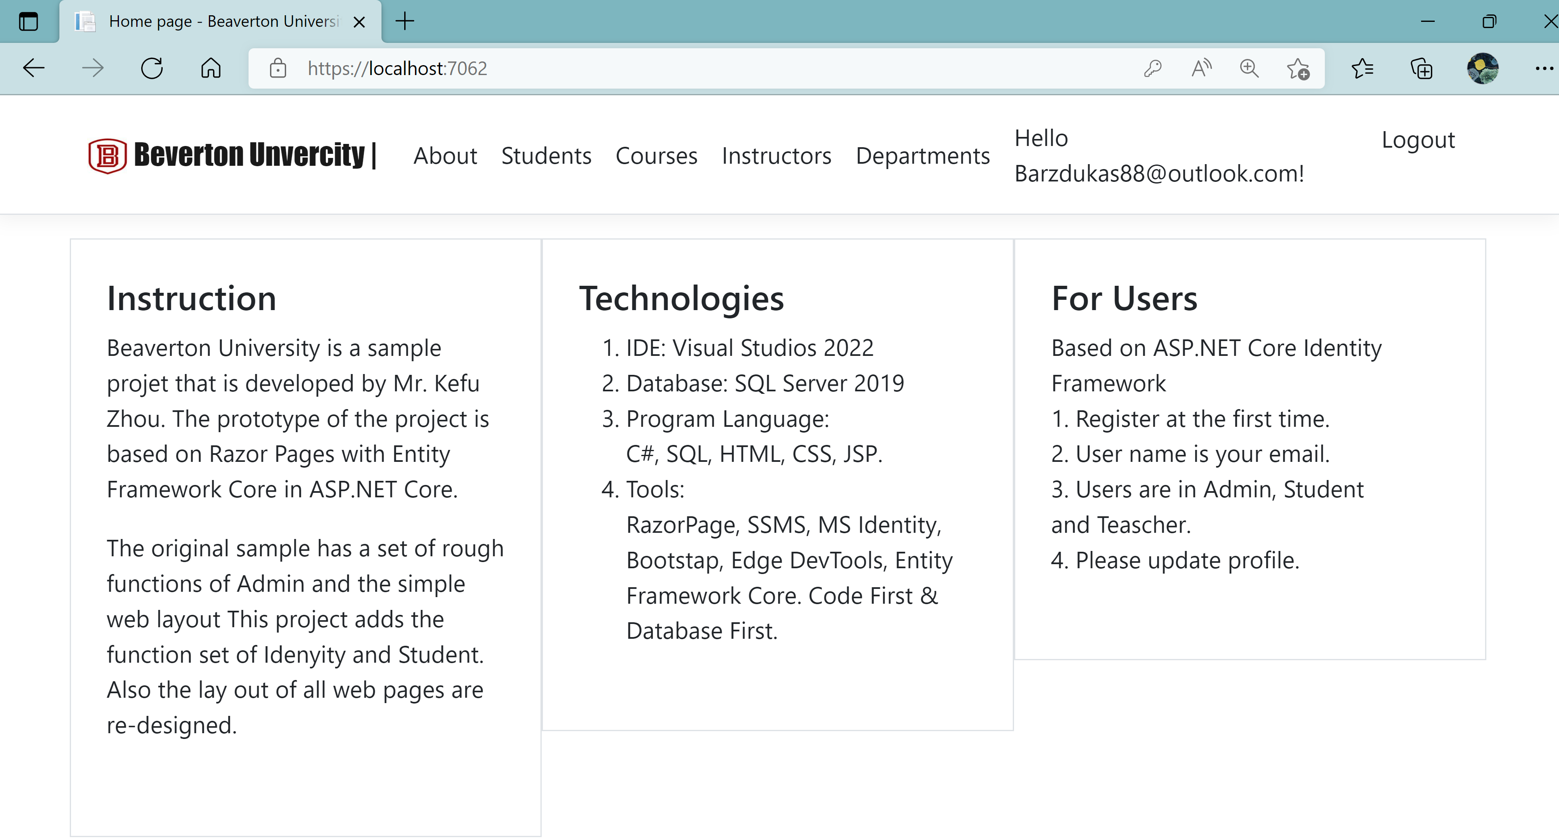

Slide 9
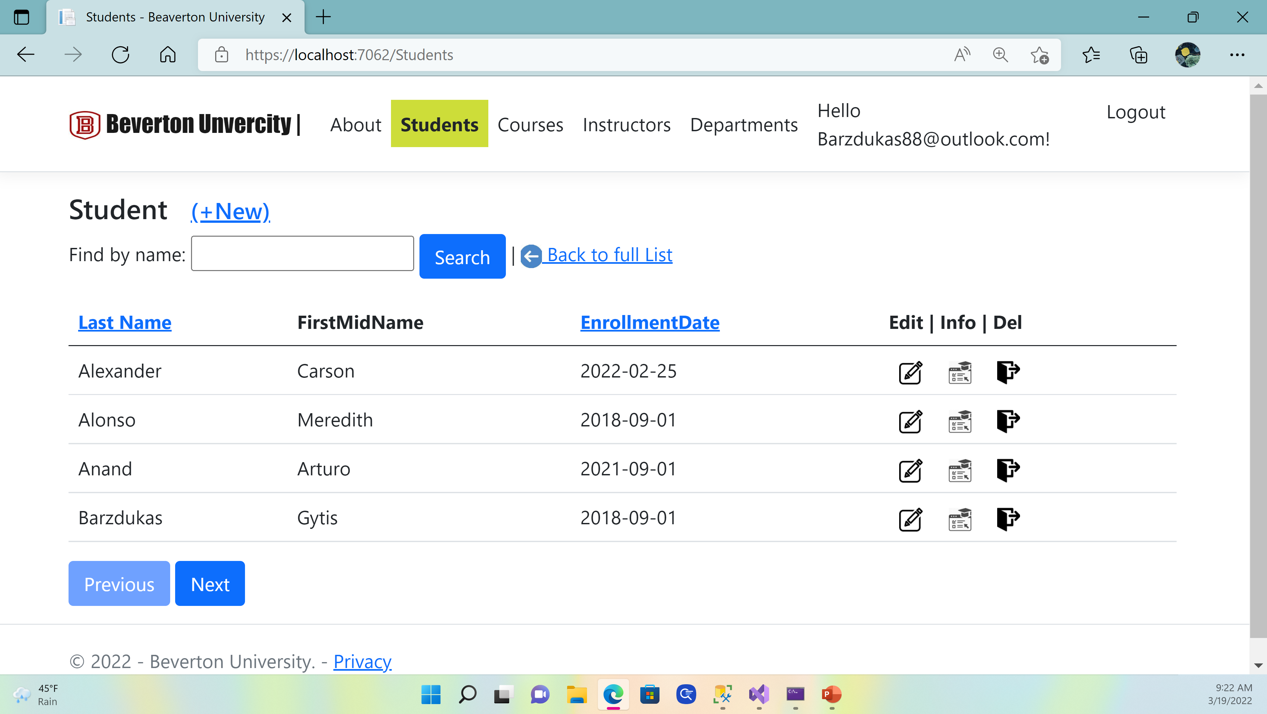
Student Index Page

Slide 10
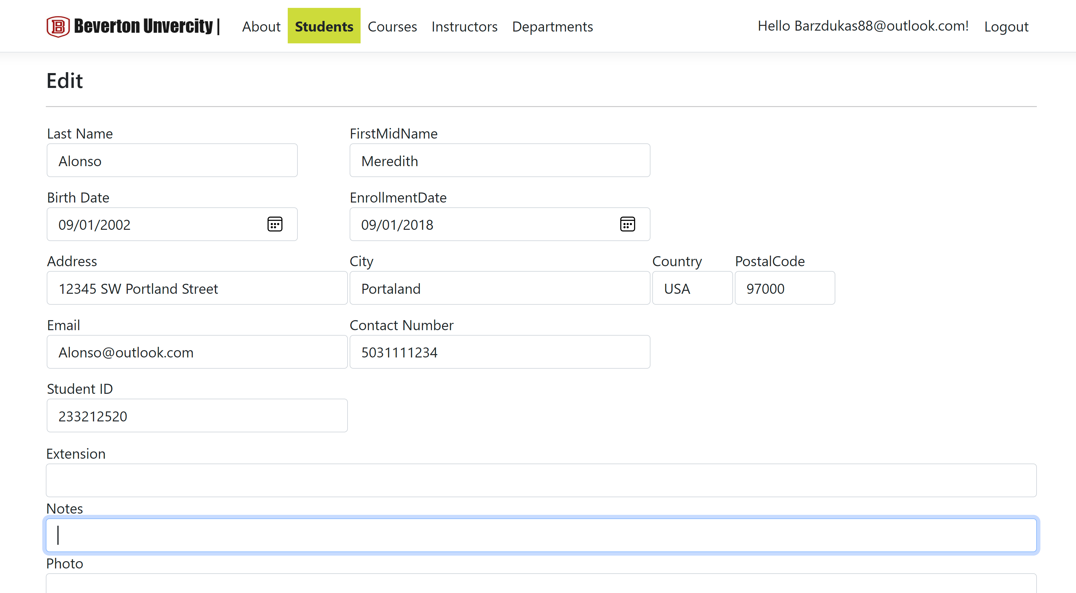
Student Edit Page

Slide 11
Razor Pages in ASP.NET Core
1. Cross platform development Applications is deployed to Windows, Unix and Mac operating systems.
2. Server-side and page-focused The popular C# programming language for server-side programming, and the easy-to-learn Razor templating syntax for embedding C# in HTML mark-up to generate content for browsers dynamically.
3. Razor Pages is suitable for developers of the enterprise’s info system . It includes all of the advanced features of ASP.NET Core (such as dependency injection) making it just as suitable for large, scalable, team-based projects.
ASP.NET Razor Pages is a server-side, page-focused framework that enables building dynamic, data-driven web sites with clean separation of concerns.

Slide 12
EF Core
Database and Data entity model
With EF Core, data access is performed using a data model. A model is made up of entity classes (C#) and a DB context object that represents a session with the database. The DB context object allows Razor Page application querying and saving data.
EF supports the following model development approaches:
Generate a entity model from an existing database.
Hand code a entity model to match the database.
Once a entity model is created, use EF Migrations to create a database from the model. Migrations allow evolving the database as the model changes.
Entity Framework(EF) Core is a lightweight, extensible, open source and cross-platform version of the popular Entity Framework data access technology.
EF Core can serve as an object-relational mapper (O/RM), which: Enables .NET developers to work with a database using .NET objects.
Eliminates the need for most of the data-access code that typically needs to be written.
EF Core supports many database engines as SQL Server and Oracle.

Slide 13

Bootstrap
App on iPhone
Bootstrap is the CSS Framework for developing responsive and mobile-first websites.
Bootstrap is deployed in ASP.NET Core to make Razor Pages app working on many devices, such as Smart TV, PC, iPad, Mobile phone.

Slide 14
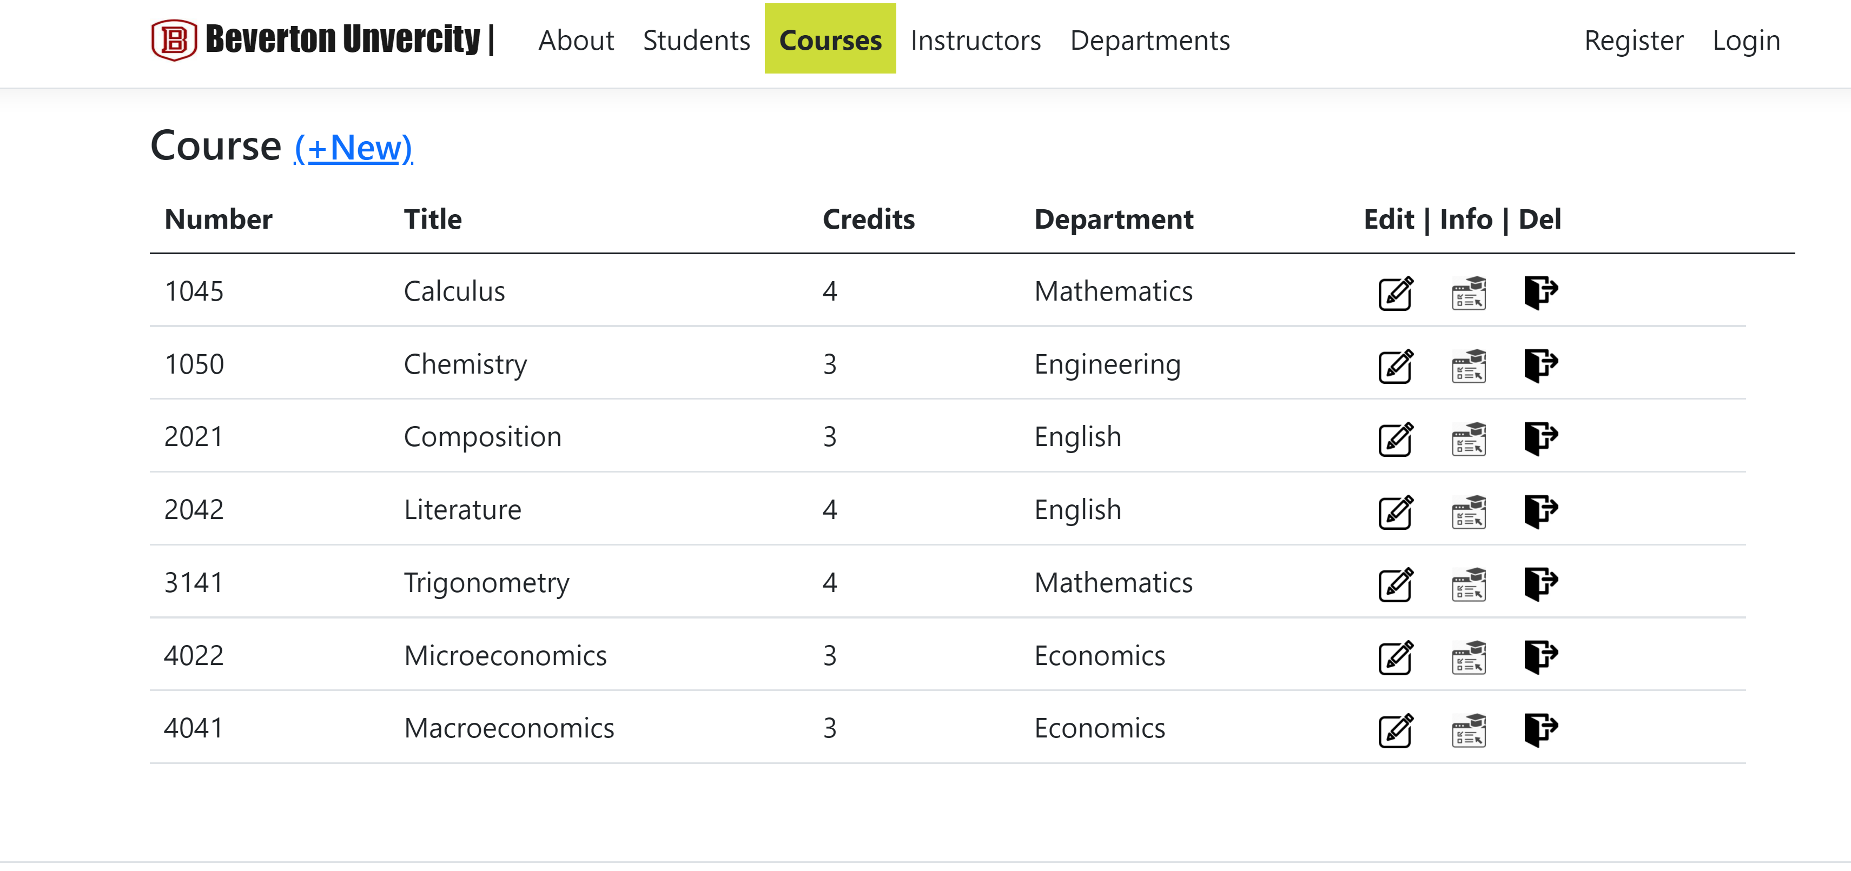
App on PC

Slide 15
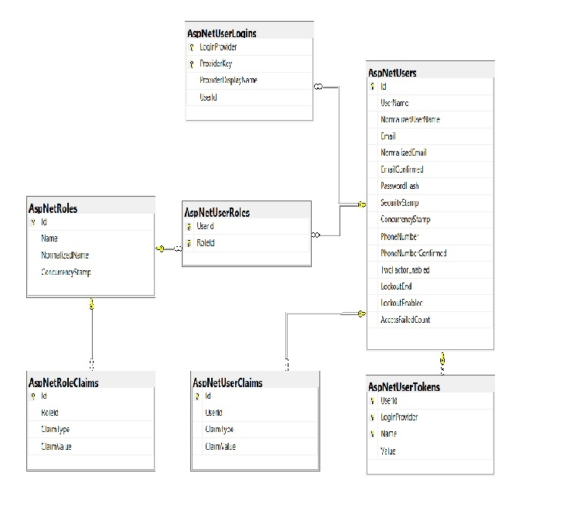
ASP.NET Core Identity framework
Identity database Schema
ASP.NET Core Identity framework is used to implement forms authentication.
There are many options to choose from for identifying your users including Windows Authentication and all of the third-party identity providers like Google, Microsoft, Facebook, and GitHub etc.

Slide 16
Project database schema

Slide 17
Inside of the project
Structure objects pages

Slide 18
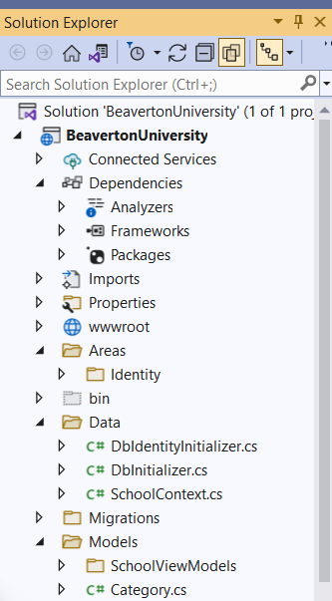
Inside-1
Top objects:
Database connection.
Asset of project such as CSS, ICON, JS, Head file.
Identity entity .
Data migration control

Slide 19
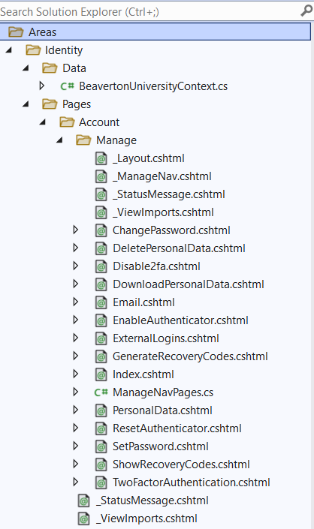
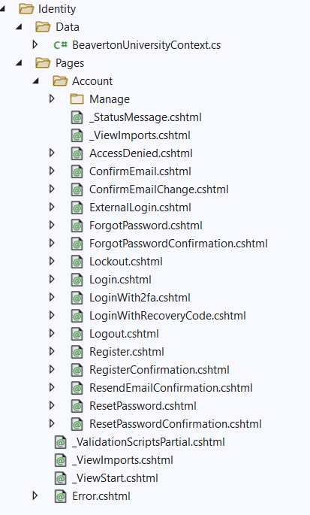
Razor pages of Identity of the project

Slide 20
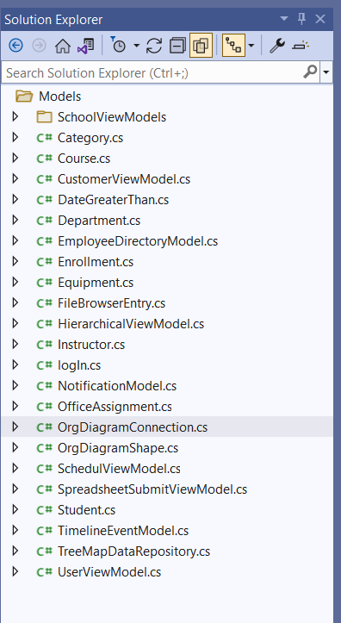
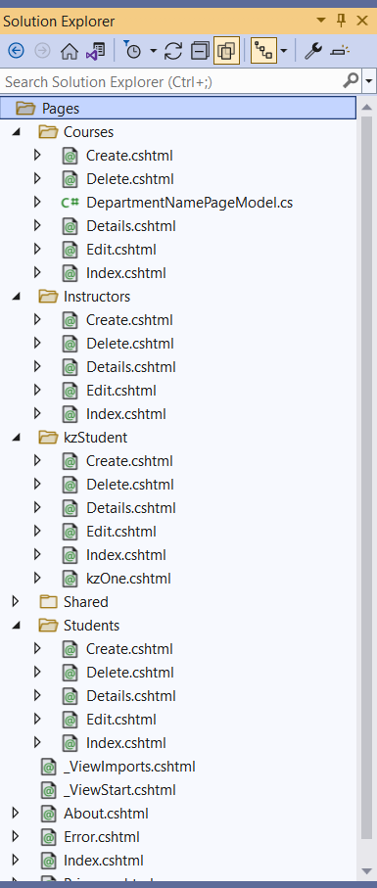
Inside of Project (2)
Data entity model
Razor pages of project

Slide 21
Skill Set
code sample

Slide 22
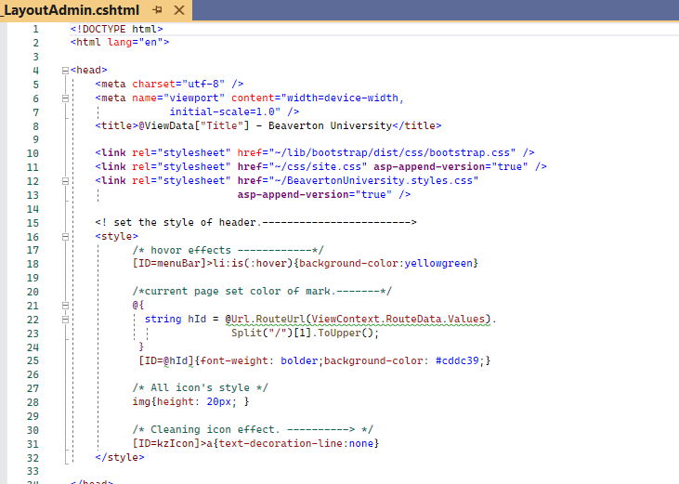
Code _layout.cshtml
Skill set:
C#
CSS
CSHTML
Razor page

Slide 23
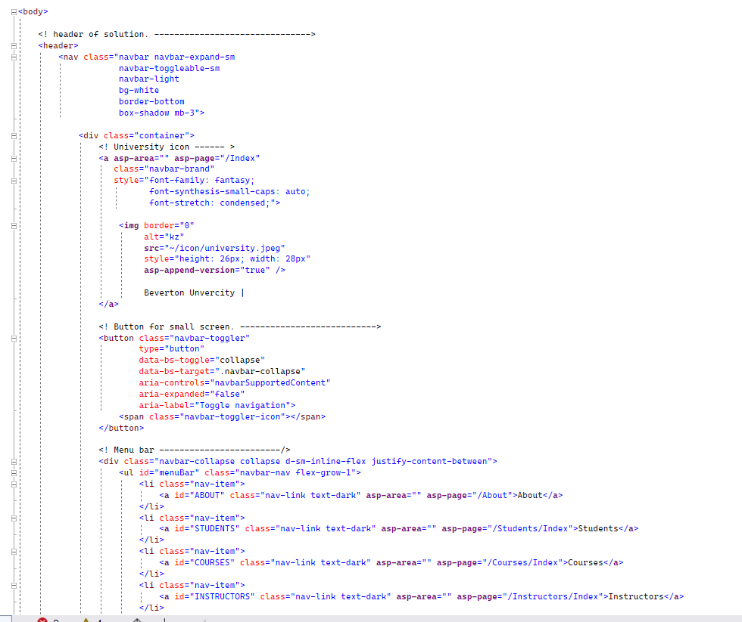
Code _layout.cshtml
Skill set:
C#, CSS
Bootstrap
CSHTML
HTML

Slide 24
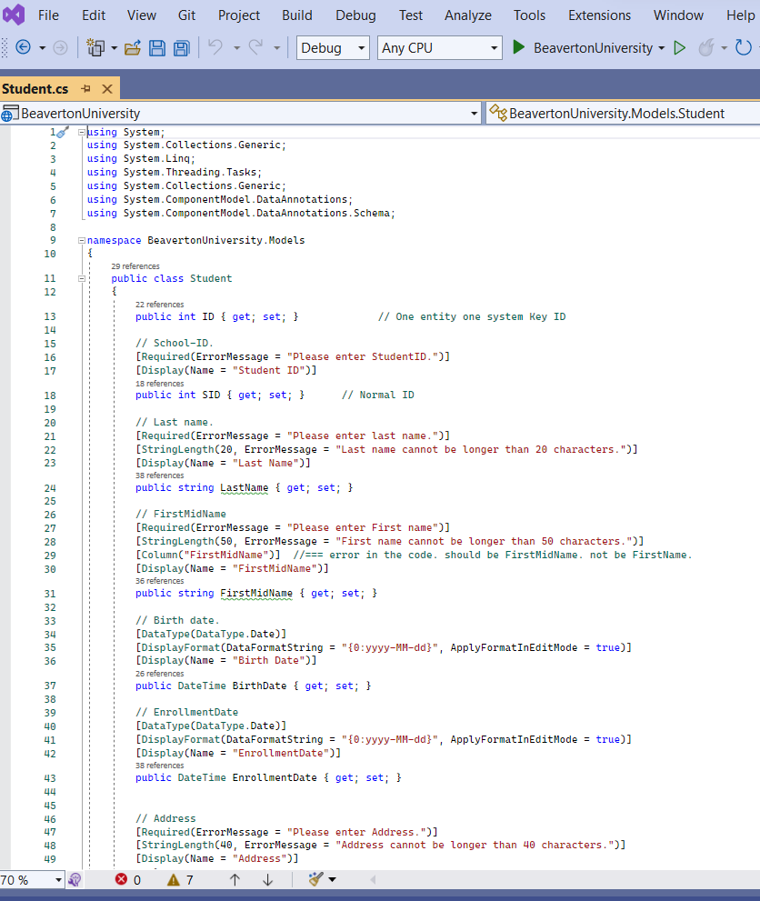
Code _student class
Skill set:
C#
Data entity class design
Tag Helpers in ASP.NET Core
Data validation
Message

Slide 25
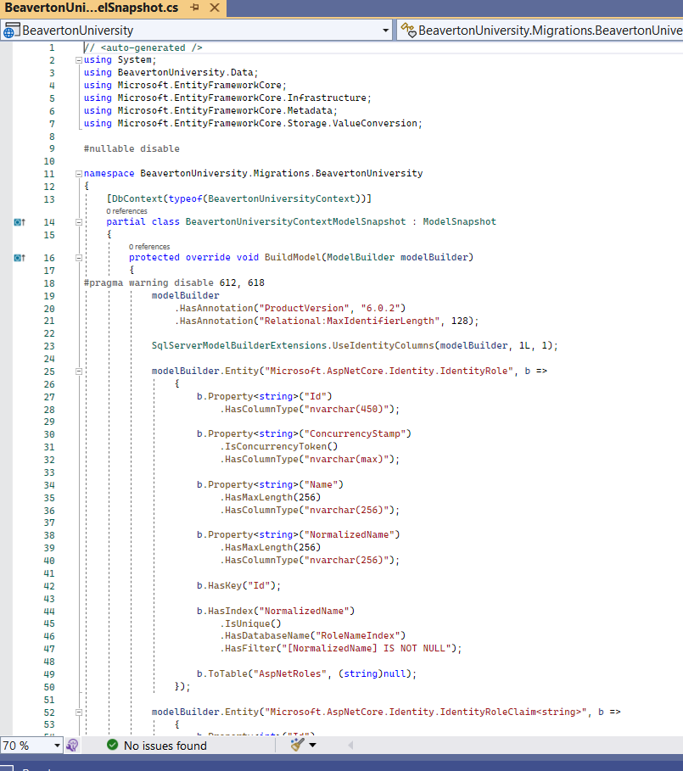
Code _data migration
Skill set:
C#
DB Context
EF Core
NuGet

Slide 26
